Slide 1
Iran University of Science and Technology
Faculty of advanced Technologies
Sensors and Actuators Project Proposal Presentation
Title:
Gravity Gradient Earth Sensor
Siavash Sabzy
Dr. M. Farajollahi
Dec. 2018

Slide 2
Table of Contents
Introduction
Goals and Challenges
MEMS GGES Properties and Specifications
Conclusion

Slide 3
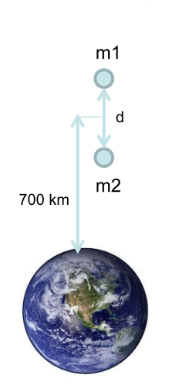
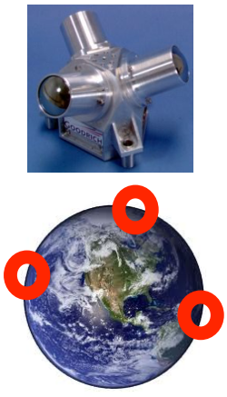
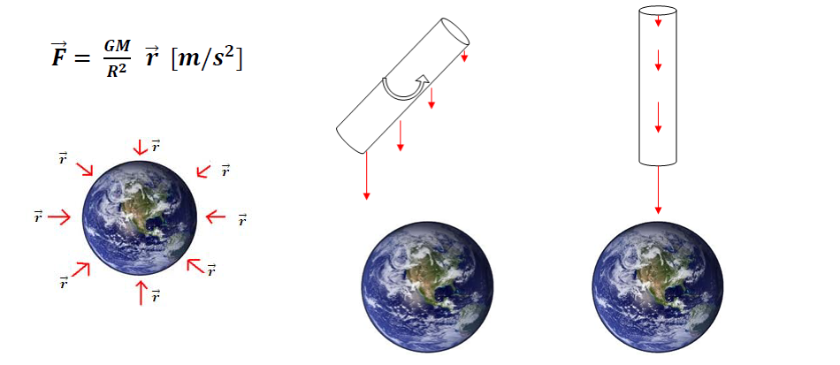
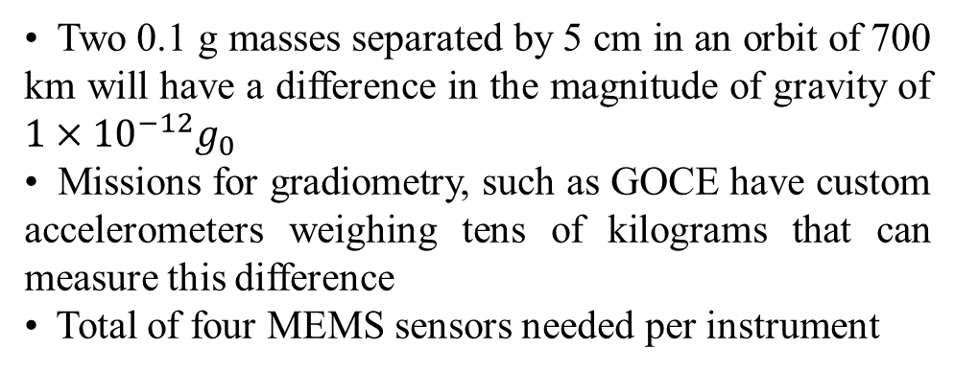
Introduction
Current Earth Sensors and sensors based on astronomical references have a limited Field of View
– Multiple units required all over satellite for complete coverage
– Limits ability to reacquire attitude on a tumbling satellite
– Prone to saturation due to presence of sun / moon in field of view
To overcome limitations of existing sensors, a new sensing scheme needed
– Use Earths gravity field as a reference
GG: Gravity Gradient
Used to passively stabilize the attitude of satellites designed with an elongated shape [GEOSAT]
• Goal – Use this phenomenon to develop an Earth Sensor with a mass of 1 kg and volume of 1 dm^3 for LEO
• Measure pitch and roll angles with an accuracy of +/- 2 degrees @ update rate 1 Hz
• Two 0.1 g masses separated by 5 cm in an orbit of 700 km will have a difference in the magnitude of gravity of $1×{10}^{−12}g_{0}$
• Missions for gradiometry, such as GOCE have custom accelerometers weighing tens of kilograms that can measure this difference
• Total of four MEMS sensors needed per instrument

Slide 4
Goals and Challenges
Goals
For the attitude determination instrument with MEMS ES
– Single unit with 4pi steradian coverage
– +/- 2° accuracy
– Volume < 1 dm^3
– Mass < 1 kg
– Power < 5 W
– Update rate > 1 Hz
Challenges
To achieve sufficient Signal to Noise Ratio to measure pitch and roll with the required accuracy in LEO:
– “Big” proof mass desired (0.1 g)
– Soft spring needed
– Develop a reliable fabrication process and packaging so that sensor can be fabricated and tested in 1g
– Test setup to reproduce the expected displacement in microgravity in 1g
– Sensitive yet robust displacement measurement scheme capable of measuring sub-nm displacements

Slide 5
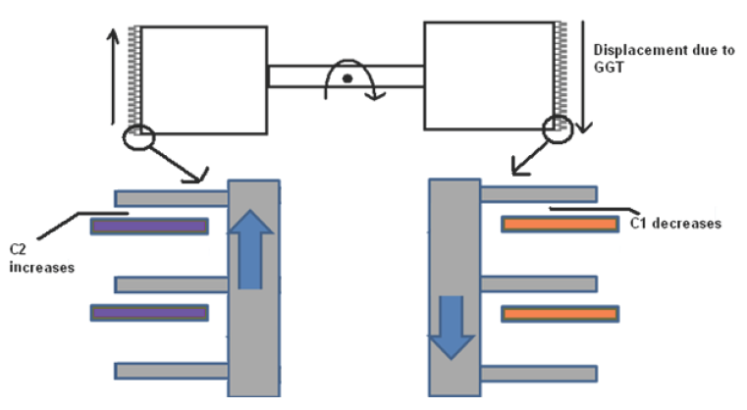
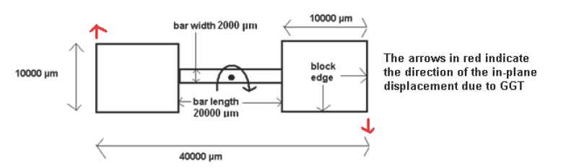
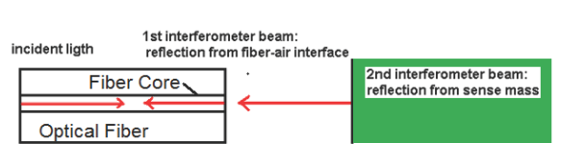
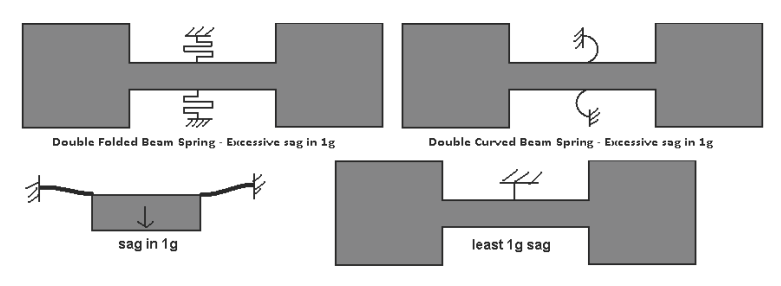
MEMS GGES

Slide 6
Conclusion
Proof Mass Properties
Proof Mass Total Length | 4 cm
Proof Mass Bar Length | 2 cm
Proof Mass Bar Breadth | 0.2 cm
Proof Mass Breadth at extremities | 1 cm
Proof Mass Thickness | 600 μm
Proof Mass Maximum Moment of Inertia | 6.9 x 10^-8 N.m^2
Proof Mass Weight | 0.33 g
Spring Properties
Spring Length | 1000 μm
Spring Width | 15 μm
Spring Depth | 100 μm
Sensor resonant frequency | 1.36 Hz
Hard Stops
Lateral Clearance | 30 μm
Vertical clearance | <4 μm
Optical Displacement Sensing
Fiber tip distance from Proof Mass | 35 μm
Laser Wavelength | 635 nm

